Slide 1
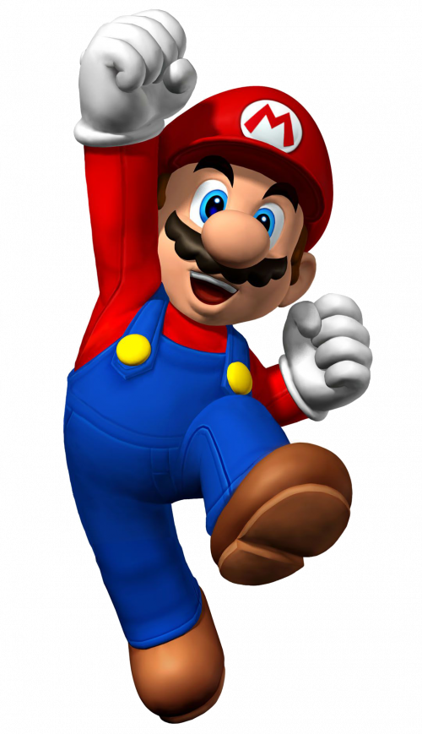
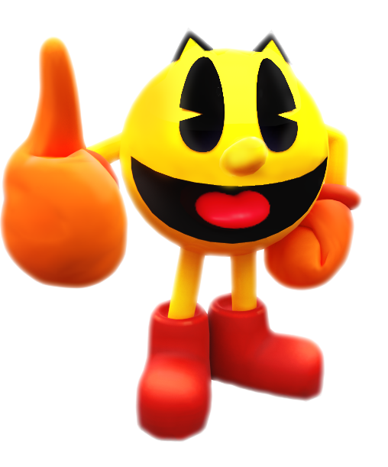
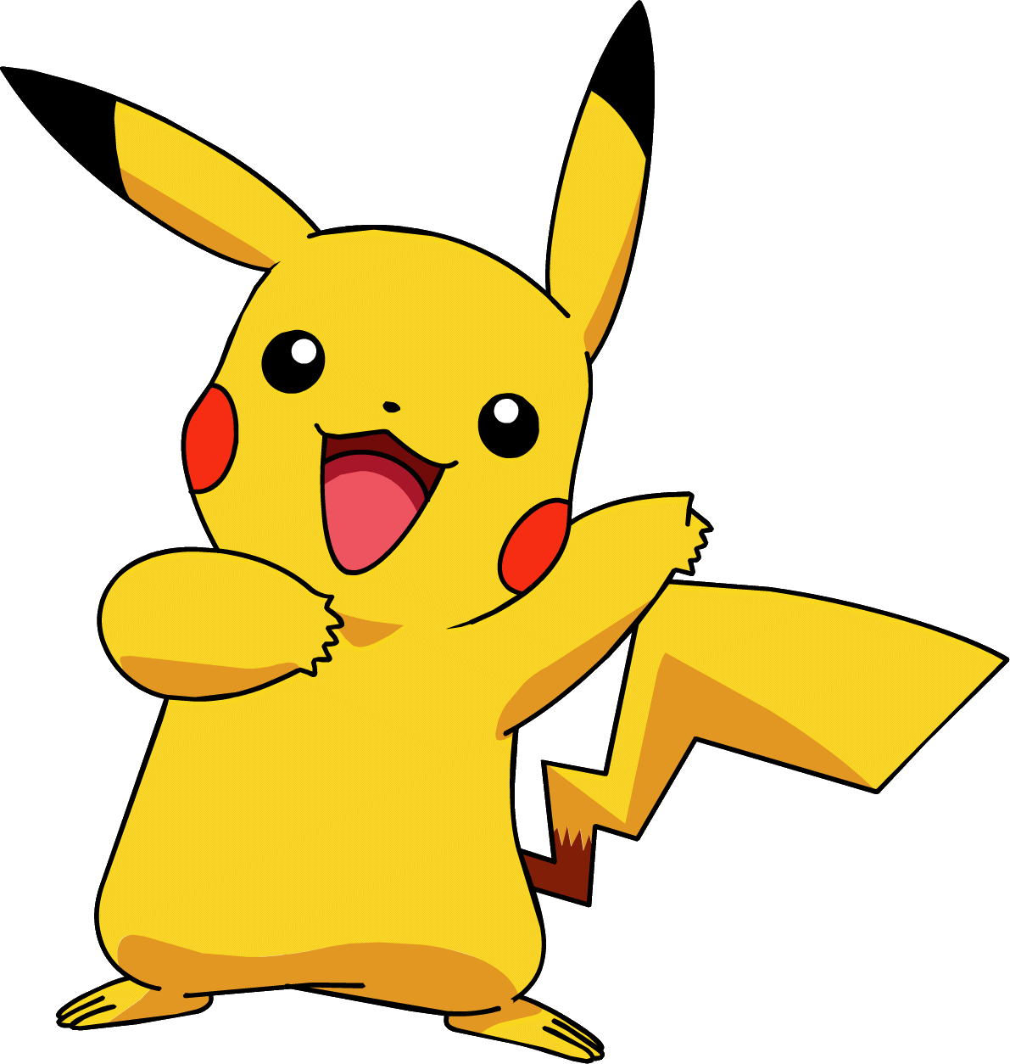
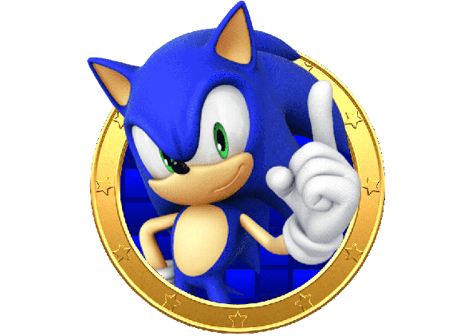
Mixed Adventures

Slide 2
Super Mario
Super Mario (also known as Super Mario Bros) is a platform game series created by Nintendo starring their mascot, Mario. It is the central series of the greater Mario franchise. At least one Super Mario game has been released for every major Nintendo video game console. There are more than 20 games in the series.
The Super Mario games are set primarily in the fictional Mushroom Kingdom, typically with Mario as the player character. He is usually joined by his brother, Luigi, and often by other members of the Mario cast. As platform games, they involve the player character running and jumping across platforms and atop enemies in themed levels. The games have simple plots, typically with Mario and Luigi rescuing the kidnapped Princess Peach from the primary antagonist, Bowser. The first game in the series, Super Mario Bros., released for the Nintendo Entertainment System (NES) in 1985, established the series' core gameplay concepts and elements. These include a multitude of power-ups and items that give the character special powers such as fireball-throwing and size-changing.

Slide 3
Sonic
Sonic the Hedgehog is a Japanese video game series and media franchise created by Sega. The franchise follows Sonic, an anthropomorphic blue hedgehog who battles the evil Doctor Eggman, a mad scientist. The main Sonic the Hedgehog games are platformers mostly developed by Sonic Team; other games, developed by various studios, include spin-offs in the racing, fighting, party and sports genres. The franchise also incorporates printed media, animations, feature films, and merchandise.
Sega developed the first Sonic game, released in 1991 for the Sega Genesis, to compete with Nintendo's mascot Mario. Its success helped Sega become one of the leading video game companies during the fourth generation of video game consoles in the early 1990s. Sega Technical Institute developed the next three Sonic games, plus the spin-off Sonic Spinball (1993). A number of Sonic games were also developed for Sega's 8-bit consoles, the Master System and Game Gear. After a hiatus during the unsuccessful Saturn era, the first major 3D Sonic game, Sonic Adventure, was released in 1998 for the Dreamcast. Sega exited the console market and shifted to third-party development in 2001, continuing the series on Nintendo, Xbox, and PlayStation systems.

Slide 4
Pac-Man
Pac-Man, originally called Puck Man in Japan, is a 1980 maze action video game developed and released by Namco for arcades. In North America, the game was released by Midway Manufacturing as part of its licensing agreement with Namco America. The player controls Pac-Man, who must eat all the dots inside an enclosed maze while avoiding four colored ghosts. Eating large flashing dots called "Power Pellets" causes the ghosts to temporarily turn blue, allowing Pac-Man to eat them for bonus points.
Game development began in early 1979, directed by Toru Iwatani with a nine-man team. Iwatani wanted to create a game that could appeal to women as well as men, because most video games of the time had themes of war or sports.[5][citation needed] Although the inspiration for the Pac-Man character was the image of a pizza with a slice removed, Iwatani has said he also rounded out the Japanese character for mouth, kuchi. The in-game characters were made to be cute and colorful to appeal to younger players. The original Japanese title of Puck Man was derived from the titular character's hockey puck–like shape; the title was changed for the North American release to mitigate vandalism.

Slide 5
Pokemon
Pokémon (an abbreviation for Pocket Monsters in Japan) is a Japanese media franchise managed by The Pokémon Company, founded by Nintendo, Game Freak, and Creatures. The franchise was created by Satoshi Tajiri in 1996, and is centered around fictional creatures called "Pokémon". In Pokémon, Pokémon Trainers are people who catch, train, care for, and battle with Pokémon. The English slogan for the franchise is "Gotta Catch ‘Em All!". There are currently 1008 Pokémon species.
The franchise began as Pocket Monsters: Red and Green (later released outside of Japan as Pokémon Red and Blue), a pair of video games for the original Game Boy handheld system that were developed by Game Freak and published by Nintendo in February 1996. Pokémon soon became a media mix franchise adapted into various different media. Pokémon is one of the highest-grossing media franchise of all time. The Pokémon video game series is the third best-selling video game franchise of all time with more than 440 million copies sold and one billion mobile downloads.

Slide 6
What is Mixed Adventures ?
Idea: Why not make a platformer game consisting of the most well-known games out there?
Mixed Adventures is a merge of Super Mario, Sonic, Pac-Man and Pokemon games in a single platformer game. The idea was also inspired by Super Smash Bros.

Slide 7
PROS:
Almost everyone likes at least one of the games
It is very easy to find game sprites and sounds
It is fun remembering the past
CONS:
Considered as mainstream games
Copyrights & Nintendo

Slide 8
Game Features
Interactive main menu, options menu (includes the ability to mute, clear player data and use cheats), level menu and player menu
Each player has the ability to sprint (shift) and double jump. Also if a player has the appropriate power up he can shoot attack with “X” and he can also shoot upwards by holding the up arrow key and hitting “X”
Zoom in the camera with “I” and zoom out with “O”
4 Worlds with 4 levels in each world. Each world includes its own music, backgrounds, enemies and main character.
4 boss fights as the final level of each world. Defeating the boss fight unlocks the next world and its character
8 power ups, each power up can be picked up only by the appropriate player
Coins collection mechanism & player HP

Slide 9
Copyright Disclaimer:
I don’t own the rights of any of the music, sounds effects and sprites used in this project. They belong to their producers/ creators. This project was executed for educational purposes.

